Slide 1
HACAP FOOD RESERVOIR

Slide 2
Panel
Food Safety
Service Requirements
Operational Requirements
Non-Compliance
TEFAP
Food Reservoir
$200
$200
$200
$200
$200
$200
$400
$400
$400
$400
$400
$400
$600
$600
$600
$600
$600
$600
$800
$800
$800
$800
$800
$800
$1000
$1000
$1000
$1000
$1000
$1000

Slide 3
THE URL FOR THE FOOD RES PARTNER WEBSITE
FOOD RESERVOIR · $400

Slide 4
WHAT IS WWW.HACAP.ORG/PARTNERS
FOOD RESERVOIR · $400 ANSWER

Slide 5
THE PARTNERS THAT MUST USE PASSIVE OR ACTIVE TEMPERATURE CONTROL FOR TRANSPORTING FOOD
FOOD SAFETY · $1000

Slide 6
WHO ARE ALL PARTNERS REGARDLESS OF DISTANCE.
FOOD SAFETY · $1000 ANSWER

Slide 7
NAME AT LEAST TWO TEMPERATURE CONTROL OPTIONS
FOOD saFETY BONUS - $100

Slide 8
-THERMAL BLANKETS
-COOLERS WITH ICE PACKS
-REFRIDGERAGED TRAILERS/TRUCKS
FOOD SAFETY BONUS $100 ANSWER

Slide 9
THIS IS THE POINT AT WHICH YOU RECEIVE A PENALTY FOR NOT REPORTING STATS
NON-COMPLIANCE · $800

Slide 10
WHAT IS TWO CONSECUTIVE MISSED MONTHS OF REPORTING OR 4 LATE REPORTS IN A 12 MONTH PERIOD
NON-COMPLIANCE· $800 ANSWER

Slide 11
HOW OFTEN YOU HAVE TO PLACE AN ORDER TO REMAIN ACTIVE
oPERATIONAL REQUIREMENTS · $400

Slide 12
WHAT IS ONCE EVERY 2 MONTHS OR 4 TIMES IN A CALENDAR YEAR FOR SEASONAL PARTNERS
oPERATIONAL REQUIREMENTS · $400 Answer

Slide 13
THE COLOR OF THE 2024 SNAP TEAR OFFS
FOOD RESERVOIR · $600

Slide 14
WHAT IS NEON ORANGE
FOOD RESERVOIR · $600 ANSWER

Slide 15
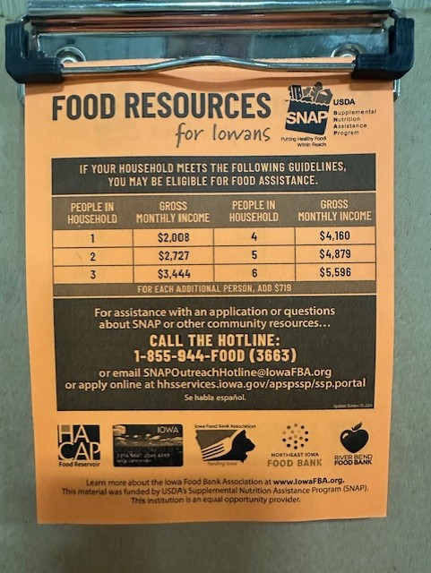
SNAP TEAR OFF

Slide 16
THE PEOPLE WHO NEED TO TAKE FOOD SAFETY TRAINING
FOOD SAFETY · $400

Slide 17
WHO ARE THE AGENCY MAIN CONTACT AND ALL DRIVERS FOR AGENCY ENABLED PICK-UP
FOOD SAFETY · $400 ANSWER

Slide 18
THIS SYSTEM NEEDS TO BE IN PLACE FOR ALL ITEMS AT YOUR AGENCY
TEFAP · $800

Slide 19
WHAT IS A USDA FOODS (TEFAP) IDENTIFICATION SYSTEM
TEFAP · $800 aNSWER

Slide 20
TWO NON-COMPLIANCE BEHAVIORS
NON-COMPLIANCE · $1000

Slide 21
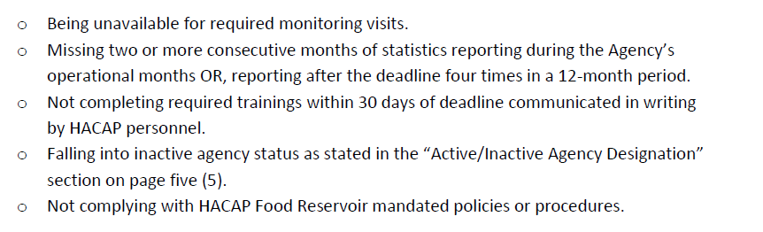
WHAT IS:
NON-COMPLIANCE · $1000 Answer

Slide 22
THESE DOCUMENTS ARE COMPLETED ON AN ANNUAL BASIS.
Food Reservoir Bonus-$100

Slide 23
WHAT IS THE ANNUAL AGREEMENT AND NETWORK CHARTER
Food RESERVOIR BONUS-$100 ANSWER

Slide 24
THE CHANGE TO THE TEFAP FORM THAT TOOK AFFECT 12/30/2024
TEFAP · $200

Slide 25
WHAT IS ASKING FOR STATE OF RESIDENCE VS. FULL ADDRESS
TEFAP · $200 aNSWER

Slide 26
THE MINIMUM FREQUENCY PARTNERS NEED TO CHECK THEIR EMAILS
OPERATIONAL REQUIREMENTS· $600

Slide 27
WHAT IS WEEKLY
OPERATIONAL REQUIREMENTS· $600 Answer

Slide 28
THE PENALTY FOR NOT ATTENDING AT LEAST ONE PARTNER AGENCY MEETING IN ANY CALEDAR YEAR
SERVICE REQUIREMENTS · $200

Slide 29
WHAT IS THE $100 MEMBERSHIP FEE
SERVICE REQUIREMENTS · $200 ANSWER

Slide 30
THIS IS THE MAXIMUM TEMPERATURE AT WHICH ALL REFRIDGERATORS SHOULD BE KEPT
FOOD SAFETY · $600

Slide 31
WHAT IS 40 DEGREES F.
FOOD SAFETY · $600 aNSWER

Slide 32
WHAT TEMPERATURES NEED TO BE RECORDED ON.
FOOD SAFETY BONUS-$100

Slide 33
WHAT IS A TEMPERATURE LOG.
FOOD SAFETY BONUS-$100 ANSWER

Slide 34
TRUE OR FALSE: IT'S ACCEPTABLE FOR VOLUNTEERS/STAFF TO CONSUME DONATED PRODUCT DURING DISTRO.
SERVICE REQUIREMENTS · $600

Slide 35
FALSE*
-FOOD SAFETY ISSUES
-MUST GO THROUGH SAME PROCESS AS EVERYONE ELSE
SERVICE REQUIREMENTS · $600 Answer

Slide 36
TRUE OR FALSE: IF A PARTNER HAS A SURPLUS OF PRODUCT THEY CAN SHARE IT AMONGST FOOD PROGRAMS IN THE AREA
Service Requirements · $800

Slide 37
FALSE
Service Requirements · $800 Answer

Slide 38
WHEN YOU NEED TO CLOSE OUT YOUR CART SO YOUR ORDER IS NOT DELETED.
FOOD RESERVOIR · $1000

Slide 39
WHAT IS BY 7:59AM 2 BUSINESS DAYS BEFORE PICK-UP OR DELIVERY
FOOD RESERVOIR · $1000 ANSWER

Slide 40
THIS IS HOW FAR OUT FROM YOUR PICK-UP/DELIVERY DAY YOU CAN SCHEDULE AN ORDER
FOOD RESERVOIR· $800

Slide 41
WHAT IS 16 CALENDAR DAYS
FOOD RESERVOIR · $800

Slide 42
THE 6 PROTECTED CIVIL RIGHTS CLASSES
SERVICE REQUIREMENTS · $1000

Slide 43
WHAT ARE: RACE, COLOR, NATL. ORIGIN, AGE, SEX (INCLUDING GENDER IDENTITY AND SEXUAL ORIENTATION), AND DISABILITY
SERVICE REQUIREMENTS · $1000 Answer

Slide 44
HOW SOON A PARTNER MUST RESIGN A PARTNERSHIP AGREEMENT AFTER THE MAIN CONTACT CHANGES
OPERATIONAL REQUIREMENTS · $800

Slide 45
WHAT IS WITHIN 30 DAYS
OPERATIONAL REQUIREMENTS · $800 Answer

Slide 46
THIS MUST BE POSTED AT ALL PARTNER SITES
Operational Requirements · $1000

Slide 47
WHAT IS THE HACAP FOOD RESERVOIR PARTNER STICKER OR WINDOW CLING
Operational Requirements · $1000 aNSWER

Slide 48

Operational Requirements

Slide 49
A REQUIREMENT THAT MUST BE MET EVERY TWO YEARS
OPERATIONAL REQUIREMENTS · $200

Slide 50
WHAT IS A MONITOR VISIT
OPERATIONAL REQUIREMENTS · $200 Answer

Slide 51
THIS TRAINING IS COMPLETED ON AN ANNUAL BASIS
TEFAP · $400

Slide 52
WHAT IS CIVIL RIGHTS TRAINING
TEFAP · $400 aNSWER

Slide 53
THIS CAN BE SUSPENDED BASED ON THE TYPE OF INFRACTION
NON-COMPLIANCE · $600

Slide 54
WHAT IS ORDER ACCESS
NON-COMPLIANCE · $600 ANSWER

Slide 55
THE FORM PROVIDED FOR ISSUES OF NON-COMPLIANCE
Non-Compliance· $200

Slide 56
WHAT IS A CORRECTIVE ACTION PLAN
Non-Compliance· $200 ANSWER

Slide 57
THE NAME OF THE POLICY FOLLOWED IF NON-COMPLIANCE IS NOT CORRECTED
NON-cOMPLIANCE · $400

Slide 58
WHAT IS THE TERMINATION POLICY
NON-cOMPLIANCE · $400 ANSWER

Slide 59
THE PHRASE POSTED ON THE BOTTOM OF YOUR OPEN HOURS
TEFAP · $600

Slide 60
WHAT IS "THIS INSTITUTION IS AN EQUAL OPPORTUNITY PROVIDER"
TEFAP · $600 ANSWER

Slide 61
ANOTHER LOCATION "THIS INSTITUTION IS AN EQUAL OPPORTUNITY PROVIDER" NEEDS TO BE PRESENT
TEFAP BONUS-$100

Slide 62
WHAT IS: ON PRINT MATERIAL THAT CANNOT ACCOMMODATE THE FULL USDA NDS
TEFAP BONUS-$100 ANSWER

Slide 63
HOW SOON INTERIM PERSONNEL MUST MEET WITH THE RPC AFTER A KEY PERSONNEL CHANGE
TEFAP· $1000

Slide 64
WHAT IS 5 BUSINESS DAYS
TEFAP· $1000 ANSWER

Slide 65
WHAT THE ACRONYM "RPC" STANDS FOR
FOOD RESERVOIR · $200

Slide 66
WHAT IS REGIONAL PARTNERSHIP COORDINATOR
FOOD RESERVOIR · $200 ANSWER
Notes:
100 bonus points to the table(s)/People for virtual that can name who the regional partnership coordinators are.

Slide 67
ACCORDING TO FEEDING AMERICA, THIS IS THE MAXIMUM NUMBER OF MONTHS WORTH OF FOOD YOU SHOULD HAVE ON HAND AT ANY TIME
FOOD SAFETY · $800

Slide 68
WHAT IS 6 MONTHS
FOOD SAFETY · $800 ANSWER

Slide 69
THIS IS HOW HIGH OfF THE FLOOR FOOD NEEDS TO BE STORED
FOOD SAFETY · $200

Slide 70
WHAT IS 6 INCHES OFF THE FLOOR
FOOD SAFETY · $200 Answer

Slide 71
AN AGENCY PARTNER MUST MEET ONE OF THESE TWO QUALIFICATIONS TO BECOME A PARTNER
SERVICE REQUIREMENTS· $400

Slide 72
WHAT IS A 501C3 OR RELEIGIOUS ORGANIZATION
SERVICE REQUIREMENTS· $400 Answer

Slide 73
Winner!

Slide 74
Credits
Special thanks to all the people who made and released these awesome resources for free:
Presentation template by SlidesCarnival

