Slide 1




Welcome!
2025 Quarter 4
Agency Partner Meeting

Slide 2
Housekeeping
Restrooms
Snackies at any time

Slide 3
Regional Partnership Coordinators
Hailey Carr
  Lead Coordinator
Mallory Stewart
  Cedar Rapids, Johnson County
Jim Mabry
  Benton, Cedar, Iowa, Jones, rural Linn, and Washington

Slide 4
Leadership
Angie Albright
  Food Reservoir Assistant Director

Slide 5
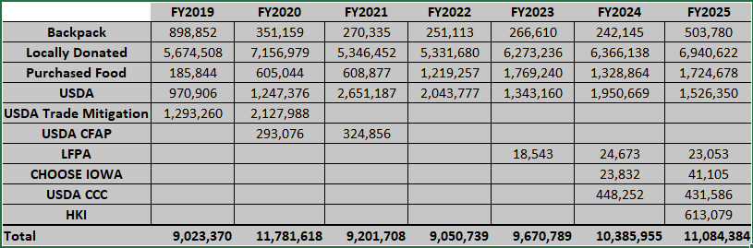
Food Reservoir a Year in Review

Slide 6
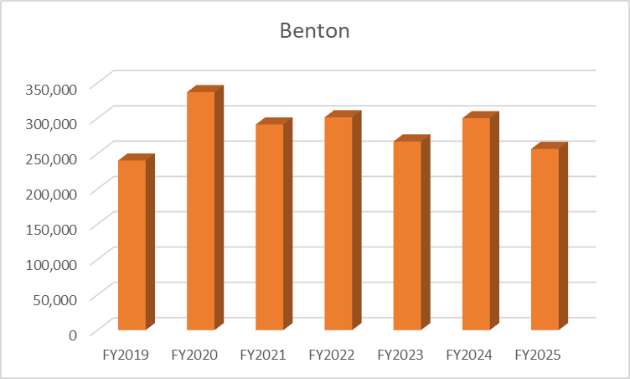
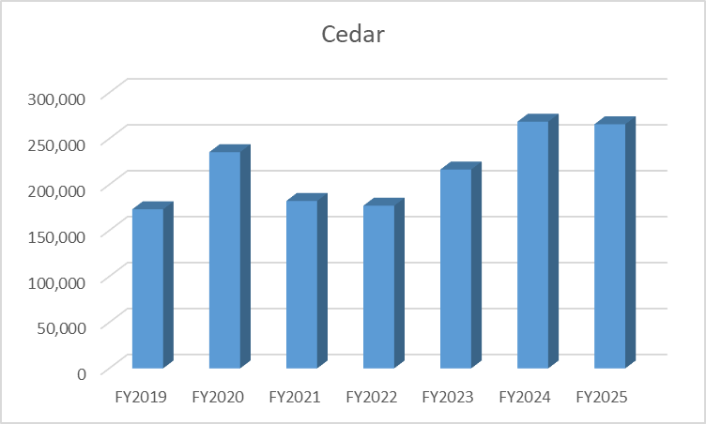
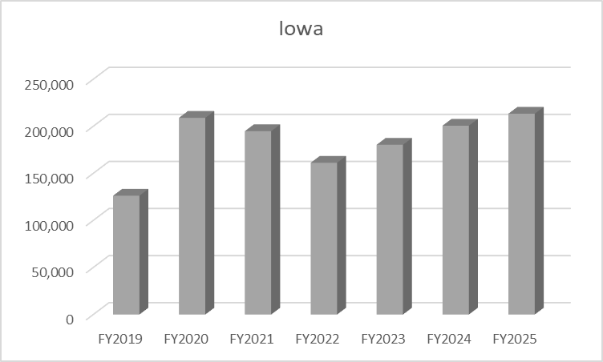
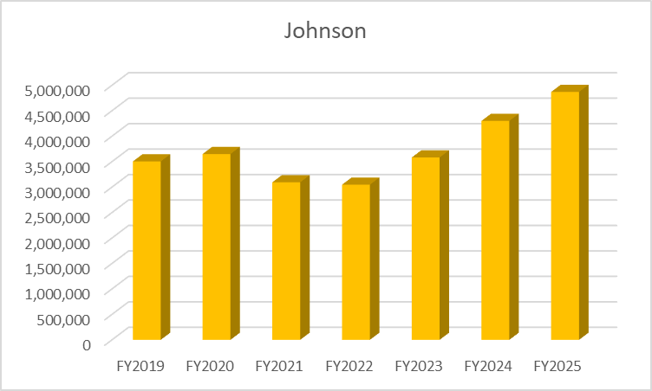
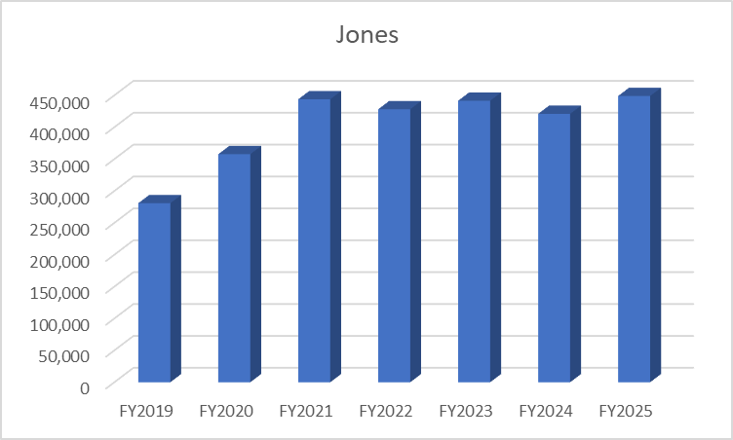
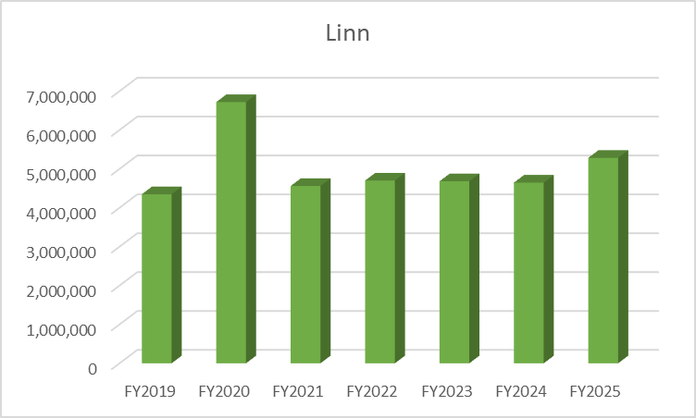
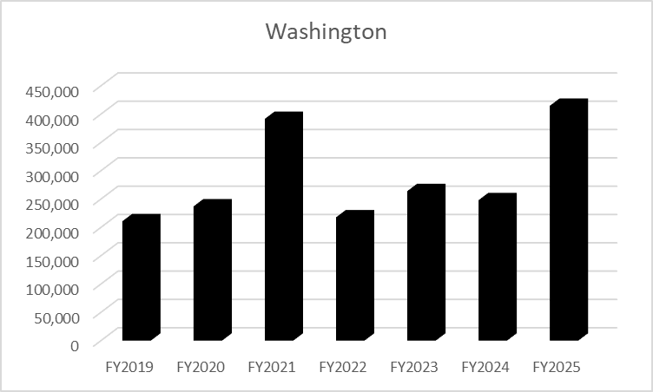

Slide 7
Questions?

Slide 8
Aron Brecht
Community Food Systems Manager

Slide 9
Questions?

Slide 10

Beach Ball Study Review

Slide 11
Lifelines
“Phone” an RPC (1 per RPC)
Ask a peer (3)
  Cannot be the same peer
Notes:
Should we do a swag drawing? However many lifelines are left is how many names we will draw for swag?

Slide 12
What needs to be in each cold storage unit?
Produce
Thermometers
Nuts
None of the above

Slide 13
What needs to be in each cold storage unit?
Produce
Thermometers
Nuts
None of the above

Slide 14
What must be checked at minimum weekly?
Temperatures
Emails
How your RPC’s week has been going
Both A and B

Slide 15
What must be checked at minimum weekly?
Temperatures
Emails
How your RPC’s week has been going
Both A and B

Slide 16
Where do I record my temperatures that I have checked at least weekly?
In PWW
In an email to my RPC
They don't need to be recorded
On a temperature log

Slide 17
Where do I record my temperatures that I have checked at least weekly?
In PWW
Email my RPC
They don't need to be recorded
On a temperature log.

Slide 18
Where can I find a temp log template?
In PWW
My RPC emails me one every month
On the partner resource page
With my order pickup/delivery

Slide 19
Where can I find a temp log template?
In PWW
My RPC emails me one every month
On the partner resource page
With my order pickup/delivery

Slide 20
Partner Resource Page
www.hacap.org/partners
Notes:
Show where log is located

Slide 21
How often do statistics need to be reported?
Once a quarter
Whenever I need to place an order
Monthly
Every other month

Slide 22
How often do statistics need to be reported?
Once a quarter
Whenever I need to place an order
Monthly
Every other month

Slide 23
What is the time frame that you can report your statistics?
The last day of the month through the 5th of the following month
Any time after my last distribution of the month
By the 1st of the following month.
There’s a deadline??

Slide 24
What is the time frame that you can report your statistics?
The last day of the month through the 5th of the following month
Any time after my last distribution of the month
By the 1st of the following month.
There’s a deadline??

Slide 25
What can’t you do if your statistics are missing?
Place an order
Open your site for distribution
Contact the Food Reservoir
Accept donations from the public.

Slide 26
What can’t you do if your statistics are missing?
Place an order
Open your site for distribution
Contact the Food Reservoir
Accept donations from the public.

Slide 27
What statistics categories need to be reported on?
Whatever is easiest for me to calculate
Just my duplicated numbers
All categories listed on my account
Just my unduplicated numbers

Slide 28
What statistics categories need to be reported on?
Whatever is easiest for me to calculate
Just my duplicated numbers
All categories listed on my account
Just my unduplicated numbers

Slide 29
What needs to be prominently displayed as a TEFAP partner?
Justice for all poster
Hours of operation with the verbiage "This institution is an equal opportunity provider"
Written Notice of Beneficiary Rights
All of the above

Slide 30
What needs to be prominently displayed as a TEFAP partner?
Justice for all poster
Hours of operation with the verbiage "This institution is an equal opportunity provider"
Written Notice of Beneficiary Rights
All of the above

Slide 31
How frequently is civil rights training completed?
Once every 3 years
Once every 2 years
Annually
One time ever

Slide 32
How frequently is civil rights training completed?
Once every 3 years
Once every 2 years
Annually
One time ever

Slide 33
How do you provide proof of civil rights training completion?
Send a picture to your RPC
Scan in a copy of the training sign off sheet to your RPC
Drop off or mail a hard copy to HACAP Corporate and attention your RPC
B or C

Slide 34
How do you provide proof of civil rights training completion?
Send a picture to your RPC
Scan in a copy of the training sign off sheet to your RPC
Drop off or mail a hard copy to HACAP Corporate and attention your RPC
B or C

Slide 35
USDA foods can stay on your shelf past the date on the package.
True
B.False

Slide 36
USDA foods can stay on your shelf past the date on the package.
True
B. False

Slide 37
As a TEFAP agency, I can require proof of residency and/or income.
True
I can only require proof of address
I can only require proof of income
False

Slide 38
As a TEFAP agency, I can require proof of residency and/or income.
True
I can only require proof of address
I can only require proof of income
False

Slide 39
As a TEFAP agency I do not have to serve neighbors who come from outside my service area or designated population.
True
B. False

Slide 40
As a TEFAP agency I do not have to serve neighbors who come from outside my service area or designated population.
True
B. False

Slide 41
Both sides of the TEFAP form need to be printed and presented to neighbors.
False, the signature is on the front page, & we track visits on a spreadsheet
B. True
C. True, only if I use the back for tracking
D. False, we have to use HACAP tracking and not the back of the form.

Slide 42
Both sides of the TEFAP form need to be printed and presented to neighbors.
False, the signature is on the front page, & we track visits on a spreadsheet
B. True
C. True, only if I use the back for tracking
D. False, we have to use HACAP tracking and not the back of the form.

Slide 43
I can modify the TEFAP form.
No, not at all.
Yes, as long as it is done electronically
Yes, as long as it is hand-written in
Both B and C

Slide 44
I can modify the TEFAP form.
No, not at all.
Yes, as long as it is done electronically
Yes, as long as it is hand-written in
Both B and C

Slide 45
Partner Resource Page
www.hacap.org/partners
Notes:
Show where log is located

Slide 46
My monthly invoice looks wrong. I should:
A. Complete the “Statement Dispute” form
B. Call the HACAP Finance Department
C. Contact my RPC
D. Contact the Food Reservoir director

Slide 47
My monthly invoice looks wrong. I should:
A. Complete the “Statement Dispute” form
B. Call t he HACAP Finance Department
C. Contact my RPC
D. Contact the Food Reservoir director

Slide 48
The Statement Dispute form is found:
A. In PWW in the “Documents” section
B. By emailing my RPC
C. The what form?
D. On the partner resource page under
the “Partner Agency Resources” header.

Slide 49
The Statement Dispute form is found:
A. In PWW in the “Documents” section
B. By emailing my RPC
C. The what form?
D. On the partner resource page under
the “Partner Agency Resources” header.

Slide 50
Invoices payments are posted to our accounts:
A. In real time
B. By the end of the month (ex: Payment on 9/19 will be
reflected on my September statement)
C. One (1) month retroactively (ex: payment on 9/19 will
be reflected on my October statement)
D. Quarterly

Slide 51
Invoices payments are posted to our accounts:
A. In real time
B. By the end of the month (ex:Payment on 9/19 will be
reflected on my September statement)
C. One (1) month retroactively (ex: payment on 9/19 will
be reflected on my October statement)
D. Quarterly

Slide 52
Partner Resource Page
www.hacap.org/partners
Notes:
Show where log is located

Slide 53
Questions?

