Slide 1



HACAP Food Reservoir
Food Safety Training

Slide 2
Importance of Food Safety Training
  If food handlers do not handle food correctly it can become unsafe. These are 5 common food handling mistakes that can cause food borne illness:
  Purchasing food from an unsafe source
  Failing to cook food correctly
  Holding food at incorrect temperatures
  Using contaminated equipment
  Practicing poor personal hygiene

Slide 3
Foodborne Illness
A disease that is transmitted to people through food. Symptoms may occur within minutes to a week and because the symptoms are often flu-like, many people may not recognize that the illness is caused by harmful bacteria or other pathogens in food. In people with weakened immune systems, the infection may be more severe and lead to serious complications, including death.
The top 5 food born illnesses in the United States are:
Norovirus
Salmonella
Clostridium Perfringens
Campylobacter
Staphylococcus

Slide 4
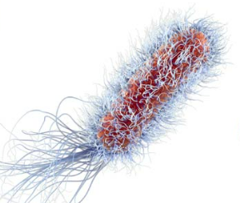
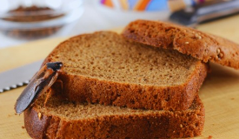
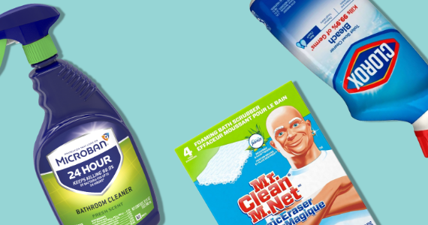
3 Types of hazards that make food unsafe:
Biological- Bacteria, viruses, fungi.
  The FDA singles out the top 6 biological contaminates. Shigella,
  Salmonella, Non-typhoidal Salmonella, E Coli, Hepatatis A, and Norovirus
Physical- bones, pits, or inorganic items in food such as glass, bugs, plastic, jewelry, etc.
Chemical- Cleaners, sanitizers, and pesticides.

Slide 5

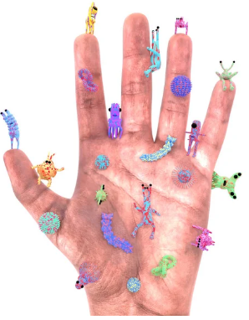
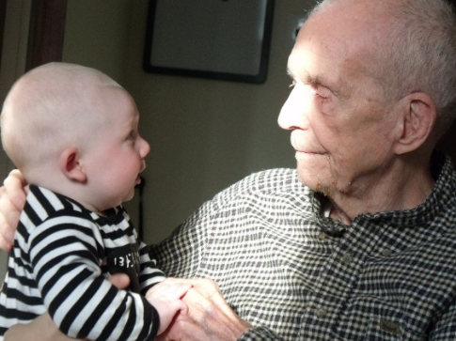
Causes of Foodborne Illness
The number 1 cause of foodborne illness is POOR PERSONAL HYGINE! Please wash your hands and cover your sneezes! Poor personal hygiene leads to the transfer of pathogens from your body to your food.
Elderly people, young children and people with compromised immune systems are at high risk of foodborne illness

Slide 6
Other Causes of Foodborne Illnesses
Cross-contamination- transferring of pathogens from one surface to another. Ex: Cutting raw meat and then using the same knife to cut up an apple to eat.
Time and Temperature abuse- food not being stored at the right temperature. Food not cooked to the correct temperature, or reheated enough to kill pathogens, or food that is not cooled correctly.
Poor cleaning and sanitation- when food equipment or surfaces are not cleaned and sanitized correctly between uses. Ex: wiping cloths left in dirty buckets of water and reused to wipe down tables multiple times.

Slide 7
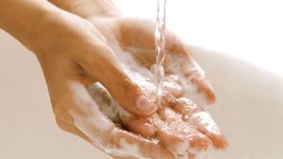
Proper Handwashing
Wet hands and arms using running water as hot as you can comfortably stand.
Apply enough soap to build up a good lather.
Scrub hands and lower arms for 10-15 seconds and include under your nails and between fingers.
Rinse hands and arms with running warm water.
Dry hands and arms, do not use your apron or part of your clothing. Use a single use paper towel or hand dryer. Use the paper towel to turn off the faucet and open the restroom door.

Slide 8
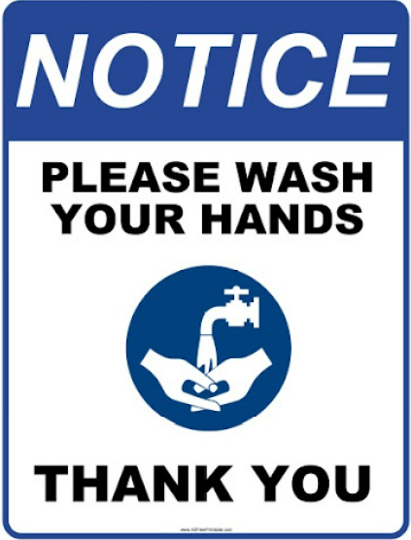
Examples of When to Wash your Hands
Before you start work
After using the restroom
After touching your hair, face or other body parts
Before and after handling raw meat
Before and after eating or drinking
After sneezing, coughing or using a tissue
After taking out garbage
After handling chemicals
After smoking
Before putting on gloves at the start of a new task

Slide 9
Other things to know about washing hands
Hand sanitizers are never to be used instead of washing.
Wash hands only in a designated handwashing sink, do not use food prep sinks for handwashing.
Sinks should have hot and cold running water, liquid soap, single use paper towels or hand dryers and garbage containers near them at all times.
Make sure sinks are never blocked and easily accessible.

Slide 10
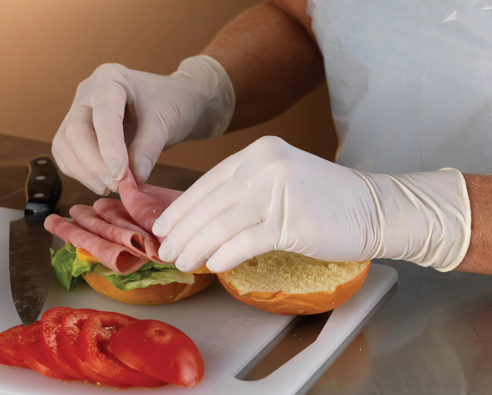
Glove Usage
Only use single use gloves when handling food.
Make sure the gloves fit your hands.
Do not blow into or roll gloves to put them on.
Never rinse, wash or reuse gloves.
Wash your hands before putting on gloves.
When to Change Gloves
If they become dirty or torn.
After handling raw meat, seafood or poultry and before handling ready to eat food.
Before beginning a new task.
Before or after handling any food with a known food allergen.
After an interruption, such as touching your phone, hair or face.

Slide 11
Personal Hygiene Tips
Keep fingernails short and clean.
Wear gloves if fingernail polish is in use.
Cover wounds with proper bandages.
If cooking, wear a clean hat or other hair covering so loose hair does not fall into food. Long hair should be tied up or put back.
If cooking, beards and mustaches must be covered.
Do not wear jewelry while handling food.
If cooking, wear a clean apron .
Do not wear watches or bracelets as they can get caught in things.
Do not smoke, chew gum or chewing tobacco around food.
If you are sick, do not go to work, especially if you have symptoms of vomiting, diarrhea, jaundice, or a sore throat with a fever.
Shower or bathe prior to your shift.
Wear clean clothes.
Store all personal belongings away from food.

Slide 12
Food Allergens
Food allergies occur when the body has a reaction to certain food items. While many different foods can cause allergic reactions, the Food Allergen Labeling and Consumer Protecting Act of 2004 identifies eight foods as major food allergens. In April of 2021, a law was signed declaring a 9th food allergen recognized by the United States.

Slide 13
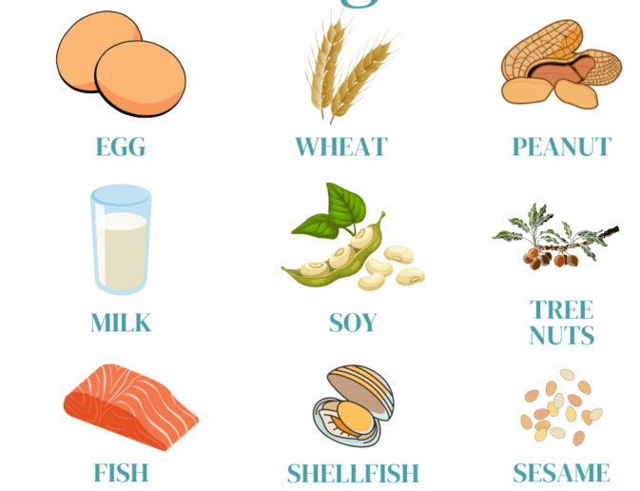
Food Allergens
Milk
Eggs
Fish (ex. bass, flounder, cod)
Crustacean shellfish (ex. crab, lobster, shrimp)
Tree nuts (ex. Almonds, walnuts, pecans)
Peanuts
Wheat
Soybeans
Sesame

Slide 14
Preventing Food Allergen Contamination
Labels are the most important way to help keep people with food allergies safe.
Place allergen signs on shelving or doorways to alert that certain products may be in use.
Clean and sanitize all surfaces that have come in contact with food containing an allergen.
Inspect food packing to ensure no leakage or spills that can cause cross contamination.
Store foods with allergens separately from allergen free products.
Wash hands and change gloves after handling a food containing allergens and before handling allergen free food.

Slide 15
Cross Contamination
  Cross contamination is the transfer of pathogens from one surface or food to another.
  Two types of cross contamination:
    Indirect- Ex: a raw chicken breast is cut with a knife on a cutting board and then the same knife and cutting board is used to cut an apple.
    Direct- A plate of raw meat is dripping and is placed on a shelf above an open pitcher of water in the refrigerator.
  How to Avoid Cross Contamination
  Cover raw food and keep it separate from ready to eat food in the fridge.
  Use clean and sanitized utensils and cutting boards.
  Store cooked and raw food separately.
  Follow proper handwashing guidelines.

Slide 16
Cross Contact
Cross contact is when a food item containing an allergen comes in contact with another food item and their proteins mix.
Isolate spilled food containing an allergen from other food products.
Inspect surrounding products to make sure they have not come in contact with the spilled food.
Dispose of any open product that can come in contact with the spilled food.
Clean and sanitize the area.
How to Avoid Cross Contact

Slide 17
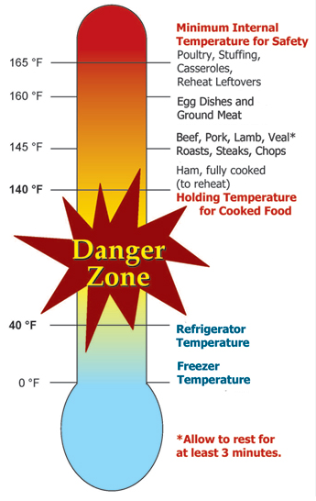
Time and Temperature Control
Most foodborne illnesses happen because TCS (temperature controlled for safety) food has been time-temperature abused. TCS abuse happens anytime the food remains between 41 degrees F and 135 degrees F. This is called the temperature danger zone because pathogens grow in this range. However, most pathogens grow much faster between 70 degrees F and 125 degrees F.
The longer food stays in the temperature danger zone, the more time pathogens have to grow. If food is held in this range for four or more hours, you must throw it out.

Slide 18
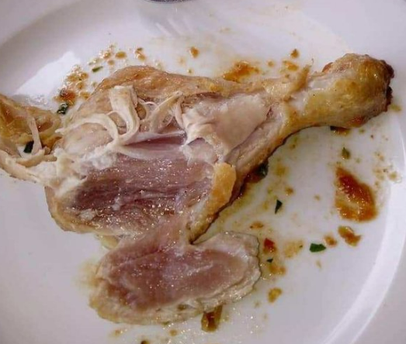
Time and Temperature Control
Food is being temperature abused anytime it is handled in the following way:
  Cooked to the wrong internal temperature.
  Held at the wrong temperature.
  Cooled or reheated incorrectly.

Slide 19
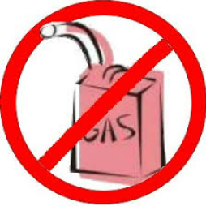
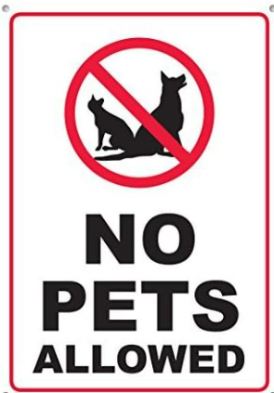
Transportation
Transportation vehicles must not have recently hauled garbage, waste, chemicals, broken glass or other materials that may contaminate food product.
Transportation vehicles must be in good condition, clean, and free of holes and infestation.
Transportation vehicles must be free of safety hazards including but not limited to fluid leaks, properly operating doors, and properly operating hatches.
No pets are allowed in the Food Reservoir. Please ensure your volunteer staff is aware of this as they are not allowed to bring pets in their vehicles during pickup.

Slide 20
Transportation
All partners regardless of travel time must adhere to the following guidelines. This includes picking up items from the HACAP Food Reservoir, as well as travel time for those agencies that pickup food from retail locations.
  Must have adequate coolers or thermal blankets for all frozen or refrigerated food.
  Ensure frozen or refrigerated product temperatures are taken and recorded prior to leaving with food. (If picking up from HACAP this will be done by staff, if picking up from a retail location, it is the agency’s responsibility).
  Ensure frozen or refrigerated product is temp checked prior to being placed in appropriate storage when food returns to agency facility.

Slide 21
Cleaning and Sanitizing Steps
Cleaning removes food and other dirt from surfaces.
Sanitizing reduces pathogens on a surface to safe levels.
When to Clean and Sanitize
Before and after use.
When changing to a new product or between allergens.
After four hours if the items have been in constant use or any time the item has become contaminated.

Slide 22
Cleaning and Sanitizing Steps
Preparation:
  Use a three compartment sink.
  Fill sink 1 with water at least 110 degrees F and add detergent.
  Fill sink 2 with water, leave empty if spray-rise items.
  Fill sink 3 with water and add the correct amount of sanitizer, use a test kit to check the strength.

Slide 23
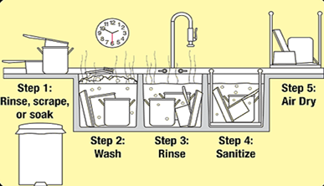
Cleaning and Sanitizing Steps
Process:
Rinse, scrape, and soak items before washing, and place in sink 1.
Wash in first sink, change the water and detergent when the suds are gone or the water is dirty.
Rinse the item in the second sink.
Sanitize in sink 3, soak for the correct amount of time as stated on sanitizer instructions.
Air dry item upside down.

Slide 24
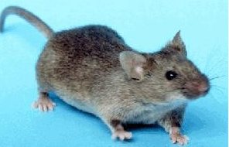
Pest Control
Watch for signs of pest control issues including droppings, nests, or damage to products.
Ensure you have a pest control program in place with a licensed company to provide ongoing pest management.
Keep food stored in appropriate locations and containers to deter pest from entering your facility.
Keep establishment clean.
Keep doors closed at all times to deny access for pest entry.

Slide 25
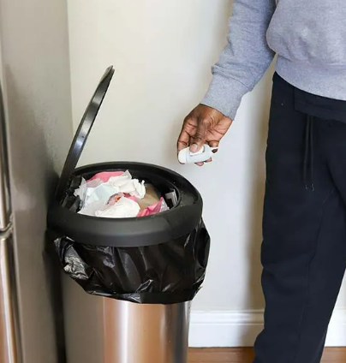
Things to know about Garbage
Remove garbage as quickly as possible.
Do not contaminate food or surfaces when removing garbage.
Do not clean garbage containers in food storage area.
Clean the inside and outside of containers often.
Keep lids on all garbage receptacles.
Keep indoor food waste containers covered and contained.

Slide 26
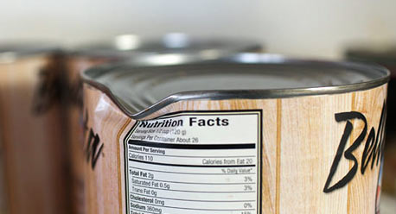
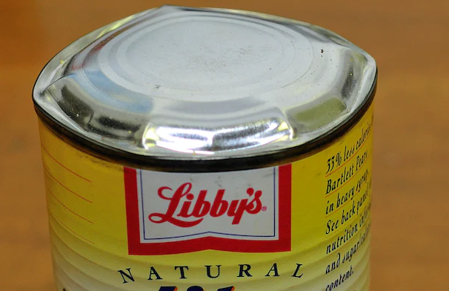
Evaluating Food Conditions
Canned Food
Canned food that is damaged or defective can cause a foodborne illness. Discard cans if they have the following defects:
  Severe dents in the seams.
  Missing labels or unreadable labels due to stains or tears.
  No code dating.
  Holes or punctures.
  Visible signs of leakage.
  Swollen or bulging ends.
  Rust that cannot be wiped off.

Slide 27
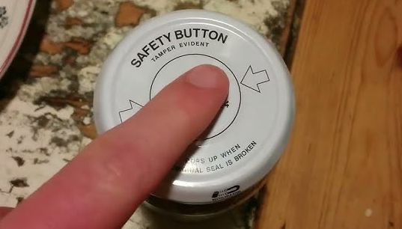
Evaluating Food Conditions
Jars and Bottles
Discard if they have the following defects:
  Lid swollen, rusted or dented.
  Missing labels or unreadable labels due to stains or tears.
  No code dating.
  Food contains mold or foreign objects.
  Signs of dirt or mold under lid.
  Lid is loose.
  Button on lid is lifted indicating the seal is broken.
  Visible signs of leaking.
  Jar is chipped or broken.
  Food is discolored.
  Food has separated or has an unusual appearance.

Slide 28
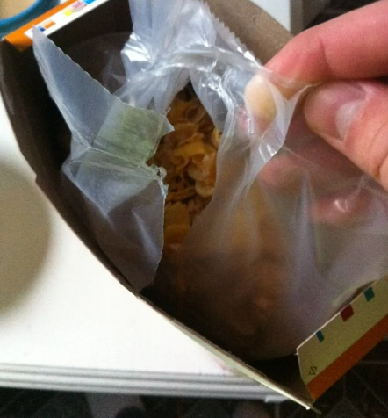
Evaluating Food Conditions
Dry Food
Discard for any of the following defects:
  Missing labels or unreadable labels due to stains or tears.
  No code date.
  Bag inside of box is open or punctured.
  Signs of pest gnaw marks on cardboard, or droppings around packaging.
  Inner package of food is damaged in any way, wet, stained, or discolored.

Slide 29
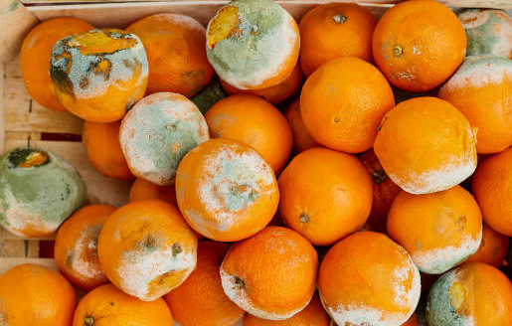
Evaluating Food Conditions
Produce Quality
Discard if any of the follow defects:
  Mold
  Decay
  Bad odor
  Signs of insects, dead or alive
  Severe bruising
  Skin not intact
  Cut produce that has not been stored at 41 degrees or lower
  Cut produce that does not have a label or code dating

Slide 30
Thank you for reviewing the training. Please go back to the website now to complete your quiz!
Once your quiz is completed your RPC will contact you with your results within 48 business hours.

